Slide 1
The Tyger
William Blake’s

Slide 2
The Tyger c. 1795
Copy A

Slide 3
Let us think
Given that tigers are not native to Britain, did Blake ever actually see a tiger?

Slide 4
Tigers in Blake’s England
Tigers could be seen in Blake’s England.
Two tigers were kept at the Tower of London.
A tiger was exhibited at Leicester House near Green Street.
Blake might have read about the tragic death of Sir Hector Munro’s son in 1792, who was mauled to death by a tiger in western India. This incident received sufficient press coverage.
Blake might have seen George Stubb’s painting of a tiger in 1769, when he was just twelve years old.

Slide 5
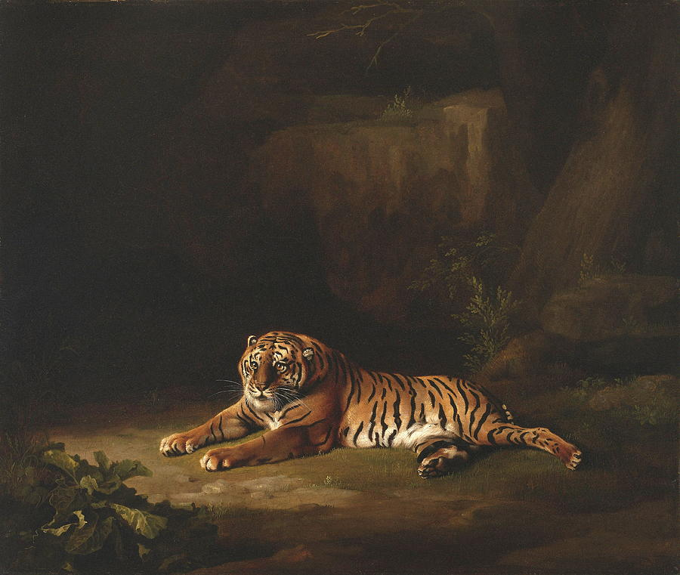
Painting by Stubbs 1769

Slide 6
Fearful Symmetry?
Tyger Tyger, burning bright, In the forests of the night; What immortal hand or eye, Could frame thy fearful symmetry?

Slide 7
Real tiger Versus Blake’s tiger
Actual Maneater
Blake’s Painting

Slide 8
The Text and the Image
The text describes the tiger as a fearful beast.
In contrast, the accompanying image presents a timid tiger with a sheepish grin.
Critics point out that the tiger in the painting looks like a stuffed animal.

Slide 9
Some Interpretations of The Tyger
The Tiger represents human desire.
The Tiger represents Experience, while the Lamb represents Innocence.
The poem is about poetry. Blake claims that only a human poet could command the creative energy to make something as complex and contradictory as the Tiger.
The Tiger represents the fires of revolution. The poem contains an oblique reference to the French Revolution.

Slide 10
The Tiger and The Lamb
“The Tyger” is often read as a counterpart to “The Lamb”.
The two poems appeared together in a volume entitled Songs of Innocence and of Experience Shewing the Two Contrary States of the Human Soul (1794).
“The Lamb” and “The Tiger” therefore reflects two contrary states of the human soul. The Lamb, Innocence; The Tiger, Experience.

Slide 11
The Two Contrary States
“The Lamb”
“The Tyger”

Slide 12
A Symbol of Evil?
We must not think of the tiger as a symbol of evil.
In another work The Marriage of Heaven and Hell (1794) Blake writes that, “The tygers of wrath are wiser than the horses of instruction.”
In the same work he also writes, “Without Contraries is no progression. Attraction and Repulsion, Reason and Energy, Love and Hate, are necessary to Human existence.”
The tiger, therefore, is necessary in the cosmic scheme of things.

Slide 13
When the stars threw down their spears And water'd heaven with their tears: Did he smile his work to see? Did he who made the Lamb make thee?
The obvious answers to these rhetorical questions are - that the Creator did smile to see his work and that the One who made the lamb, also made the tiger.

Slide 14
Probable Influence of the Kabbalah
Kabbalah, an esoteric school of Jewish mysticism speaks of ten Sefirot or emanations through which Ein Sof (The Infinite God) reveals himself.

Slide 16
Gevurah and Hesed
In Kabbalah, “Gevurah” stands for “the strength of judgment” while “Hesed” or “Chesed” stands for “loving kindness.”
In Kabbalistic understanding, Gevurah or God’s judgment counters Hesed or God’s love. Without judgment counterbalancing love, existence would not have been possible.
If the Lamb can be seen as the manifestation of Hesed, the Tiger certainly represents Gevurah.

Slide 17
This probably explains Blake’s dictum, “Without Contraries is no Progression.”

Slide 18
Summing Up
Blake’s poem “The Tyger” is not really about a tiger. The tiger stands for something else.
“The Tyger” is generally read as a companion piece to “The Lamb”.
“The Tyger” remains a complex poem open to diverse interpretations.

Slide 19
Acknowledgement
Blake’s Poetry and Designs. Edited by Mary Lynn Johnson and John E. Grant. New York: W. W. norton & Company, 2004.
Erdman, David V. “Blake: The Historical Approach.” In English Romantic Poets: Modern Essays in Criticism. Edited by M. H. Abrams. New delhi: Oxford University Press, 1975. P. 72 – 89.
Raine, Kathleen. “The Nether-World of Alchemy.” In Blake and Antiquity. New York: Routledge Classics, 2002.
The Cambridge Companion to William Blake. Edited by Morris Eaves. Cambridge: Cambridge University Press, 2004.
Weir, David. Brahma in the West: William Blake and the Oriental Renaissance. Albany: State University of New York Press, 2003.
The images used in this presentation are all taken from Wikipedia and Google Images.

Slide 20
Prepared by
Dr Ayusman chakraborty
Assistant professor in English
Taki government college, taki.

Slide 21
The end

