Slide 1
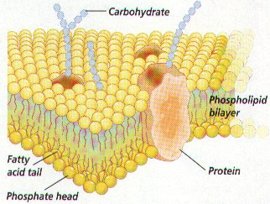
The Plasma Membrane -
Gateway to the Cell

Slide 2
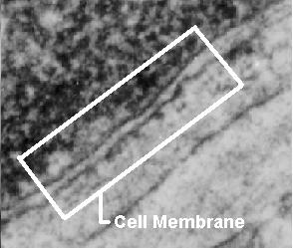
Photograph of a Cell Membrane

Slide 3
Cell Membrane
The cell membrane is flexible and allows a unicellular organism to move

Slide 4
Homeostasis
Balanced internal condition of cells
Also called equilibrium
Maintained by plasma membrane controlling what enters & leaves the cell

Slide 5
Functions of Plasma Membrane
Protective barrier
Regulate transport in & out of cell (selectively permeable)
Allow cell recognition
Provide anchoring sites for filaments of cytoskeleton

Slide 6
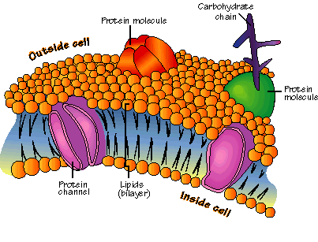
Structure of the Cell Membrane

Slide 7
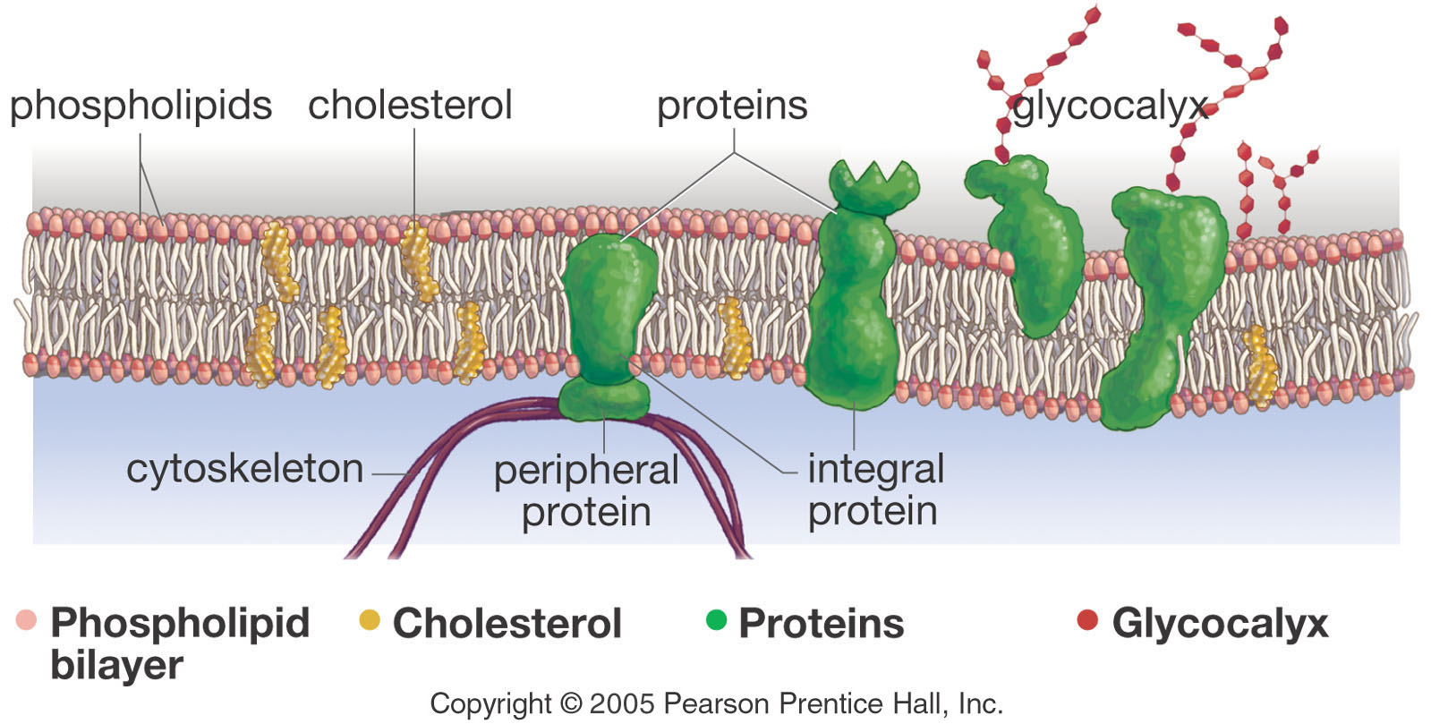
Membrane Components
Phospholipids
Proteins

Slide 8
Phospholipids
Make up the cell membrane
Contains 2 fatty acid chains that are nonpolar
Head is polar & contains a Phosphate group

Slide 9
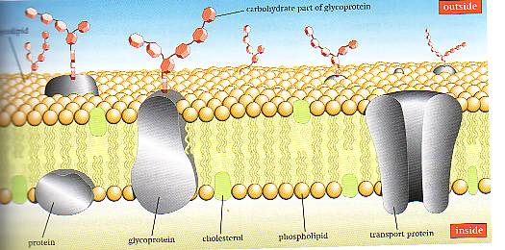
Fluid mosaic model
FLUID MOSAIC MODEL
FLUID- because individual phospholipids and proteins can move around freely within the layer, like it’s a liquid.
MOSAIC- because of the pattern produced by the scattered protein molecules when the membrane is viewed from above.

Slide 10
Cell Membrane
Polar heads are hydrophilic “water loving”
Nonpolar tails are hydrophobic “water fearing”
Makes membrane “Selective” in what crosses

Slide 12
Cell Membrane
The cell membrane is made of 2 layers of phospholipids called the lipid bilayer
Hydrophobic molecules pass easily; hydrophillic DO NOT

Slide 13
Solubility
Materials that are soluble in lipids can pass through the cell membrane easily

Slide 14
Semipermeable Membrane
Small non-charged molecules move through easily.
Examples: O₂, and CO₂

Slide 15
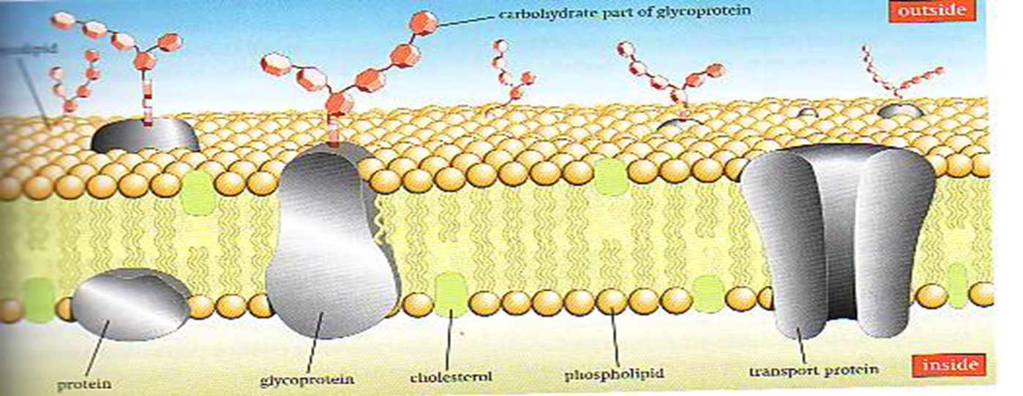
Semipermeable Membrane
Ions, and large molecules such as glucose and amino acids do not move through the membrane on their own. They must use transport proteins

Slide 16
Types of Transport Across Cell Membranes

Slide 17
Simple Diffusion
Requires NO energy
Molecules move from area of HIGH to LOW concentration

Slide 18
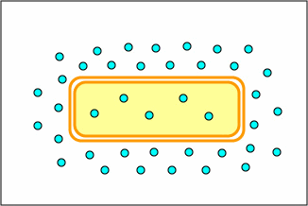
DIFFUSION
Diffusion is a PASSIVE process which means no energy is used to make the molecules move.

Slide 19
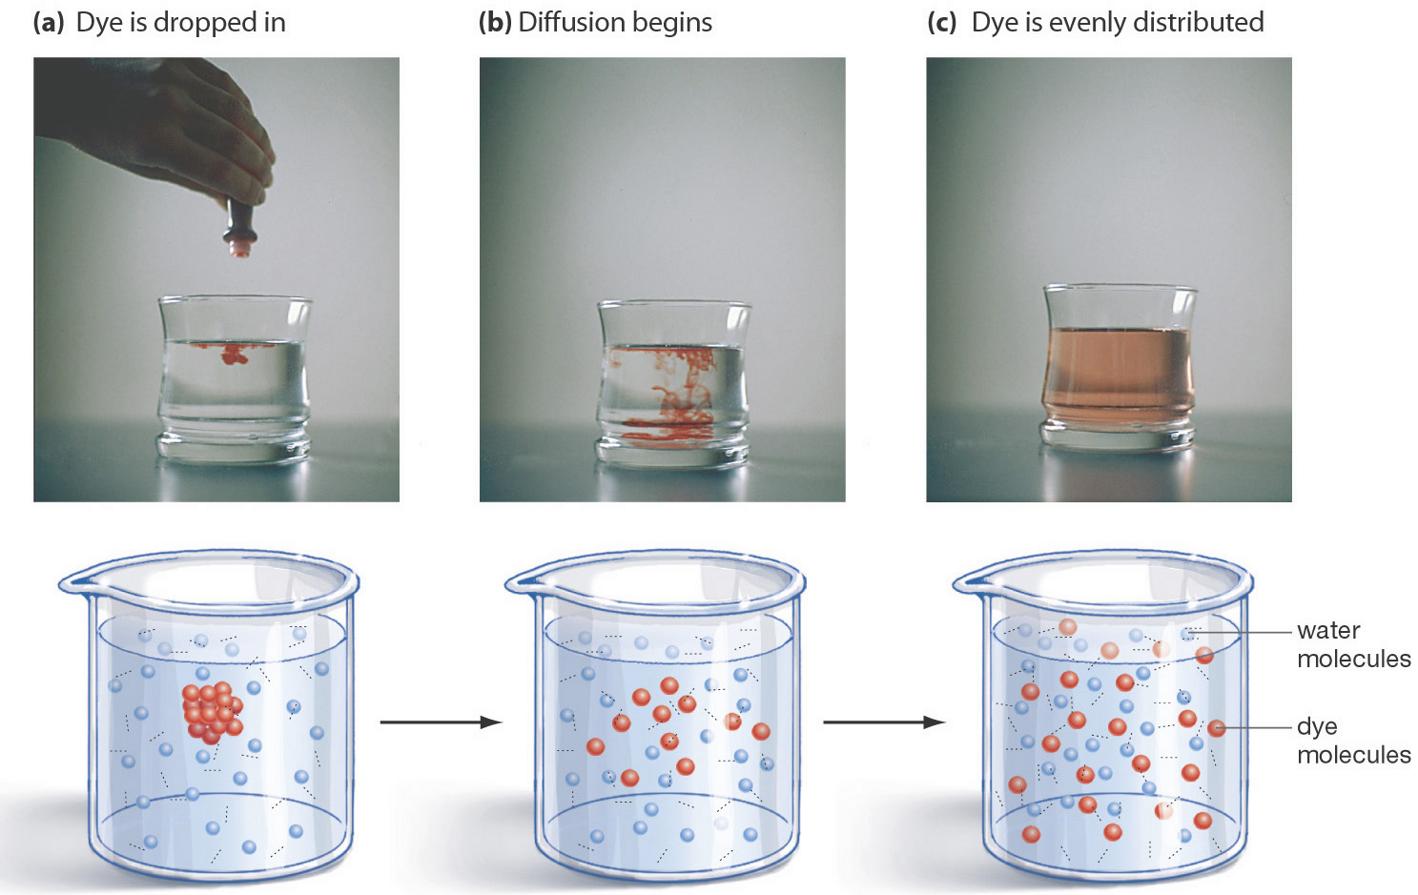
Diffusion of Liquids

Slide 20
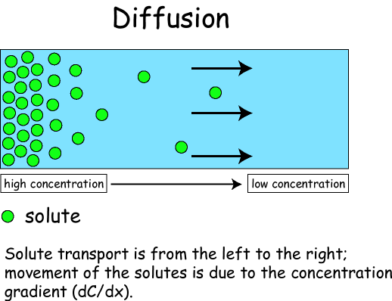
Diffusion through a Membrane
Cell membrane
Solute moves DOWN concentration gradient (HIGH to LOW)

Slide 21
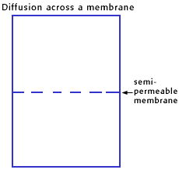
Osmosis
Diffusion across a membrane
Diffusion of water across a membrane
Moves from HIGH Concentration to a LOW concentration
Semipermeable membrane

Slide 22
Cell in Isotonic Solution
10% NaCL 90% H₂O
ENVIRONMENT
CELL
NO NET MOVEMENT
10% NaCL
90% H₂O
What is the direction of water movement?
equilibrium
The cell is at _______________.

Slide 23
Cell in Hypotonic Solution
10% NaCL 90% H₂O
CELL
20% NaCL
80% H₂O
What is the direction of water movement?

Slide 24
Cell in Hypertonic Solution
15% NaCL 85% H₂O
ENVIRONMENT
CELL
5% NaCL
95% H₂O
What is the direction of water movement?

Slide 25
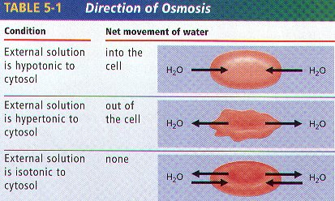
Cells in Solutions

Slide 26
Osmosis in Red Blood Cells
Isotonic
Hypotonic
Hypertonic

Slide 27
Three Forms of Transport Across the Membrane

Slide 28
Passive Transport
Simple Diffusion
Doesn’t require energy
Moves high to low concentration
Example: Oxygen diffusing in or carbon dioxide diffusing out.

Slide 29
Passive Transport
Facilitated diffusion
Doesn’t require energy
Uses transport proteins to move high to low concentration
Examples: Glucose or amino acids moving from blood into a cell.

Slide 30
Proteins Are Critical to Membrane Function

Slide 31
Active Transport
Requires energy or ATP
Moves materials from LOW to HIGH concentration
AGAINST concentration gradient

Slide 32
Active transport Sodium-Potassium Pump
Examples: Pumping Na⁺ (sodium ions) out and K⁺ (potassium ions) in against strong concentration gradients.
Called Na+-K+ Pump

Slide 33
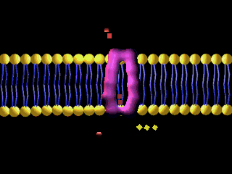
Sodium-Potassium Pump
3 Na+ pumped in for every 2 K+ pumped out; creates a membrane potential

Slide 34
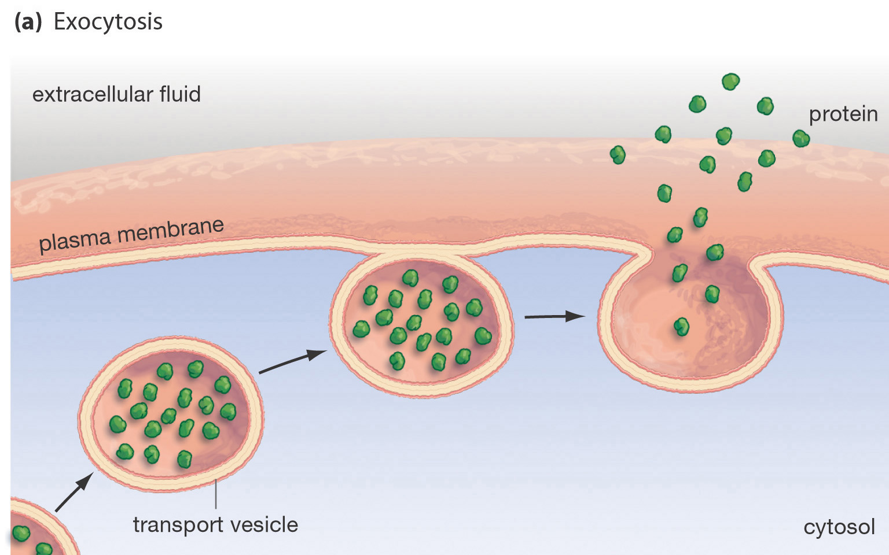
Moving the “Big Stuff”
Exocytosis- moving things out.
Molecules are moved out of the cell by vesicles that fuse with the plasma membrane.
This is how many hormones are secreted and how nerve cells communicate with one another.

Slide 35
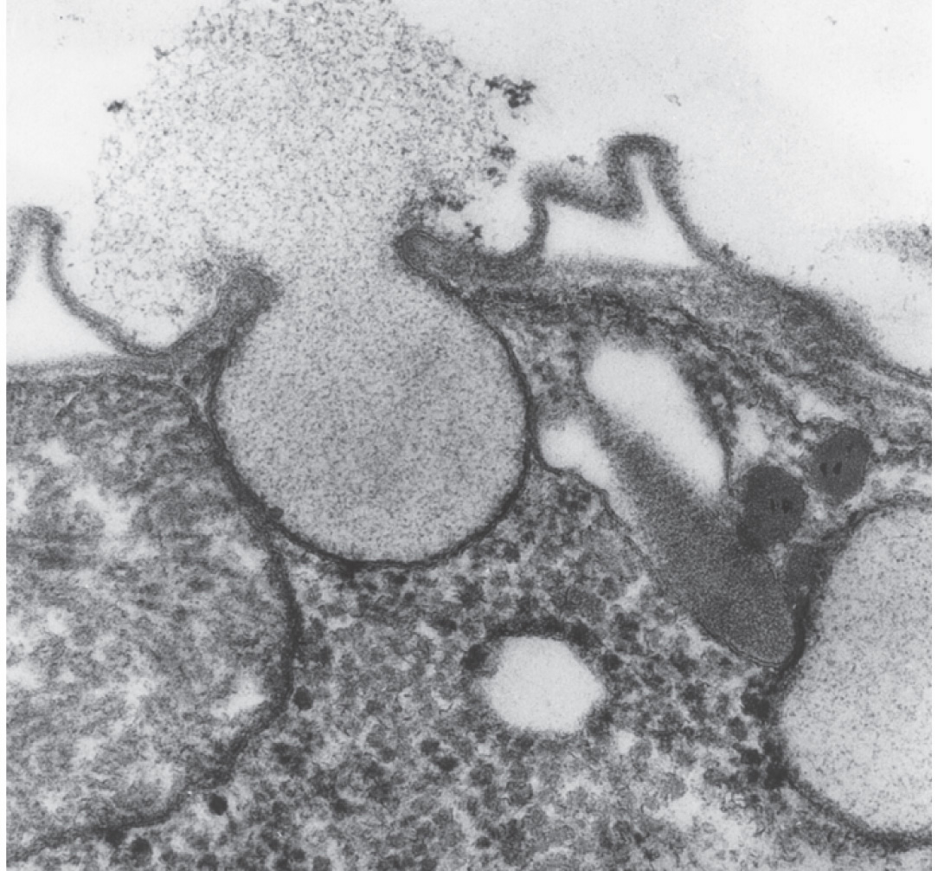
Exocytosis
Exocytic vesicle immediately after fusion with plasma membrane.

Slide 36
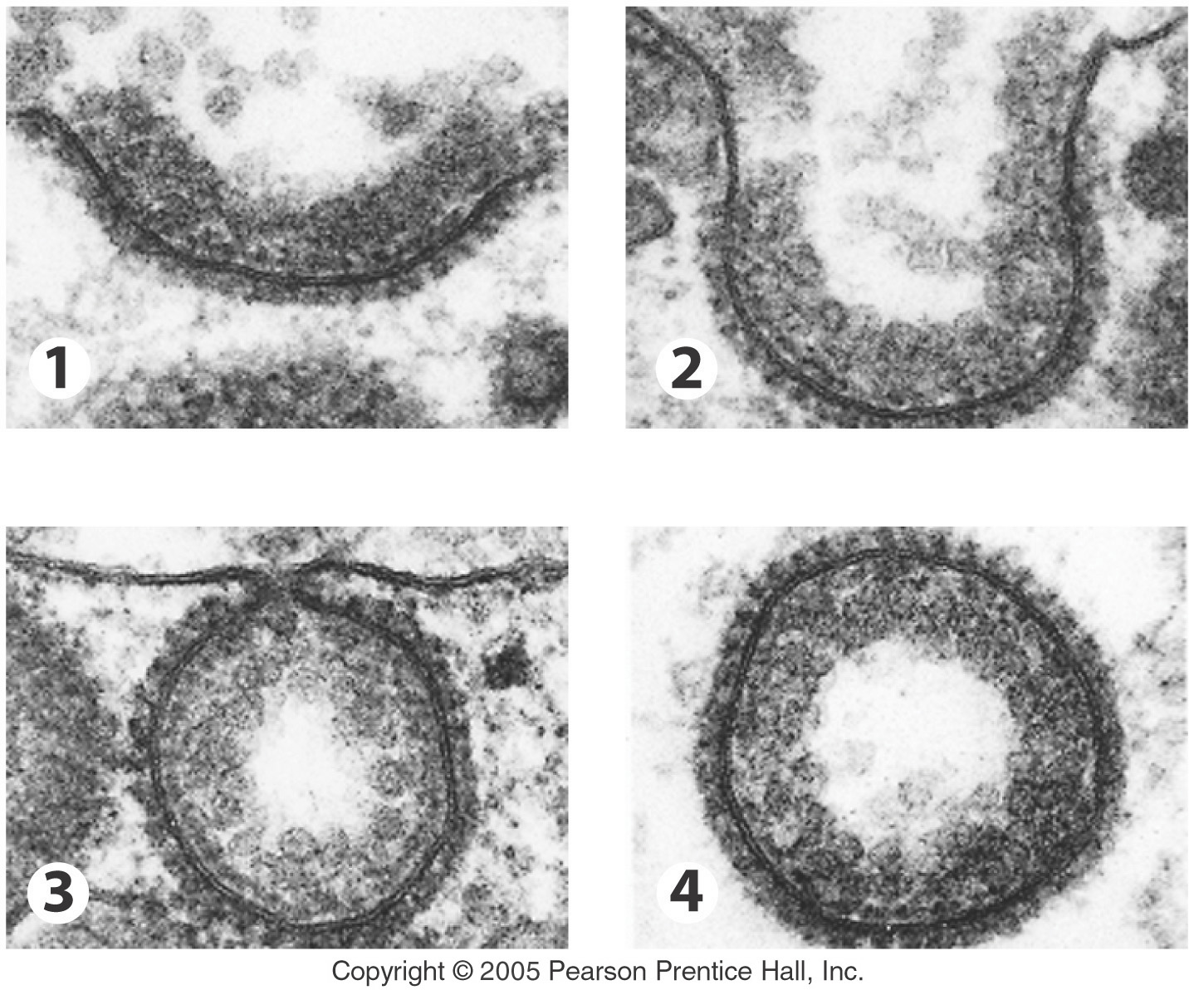
Moving the “Big Stuff”
Large molecules move materials into the cell by one of three forms of endocytosis.

Slide 37
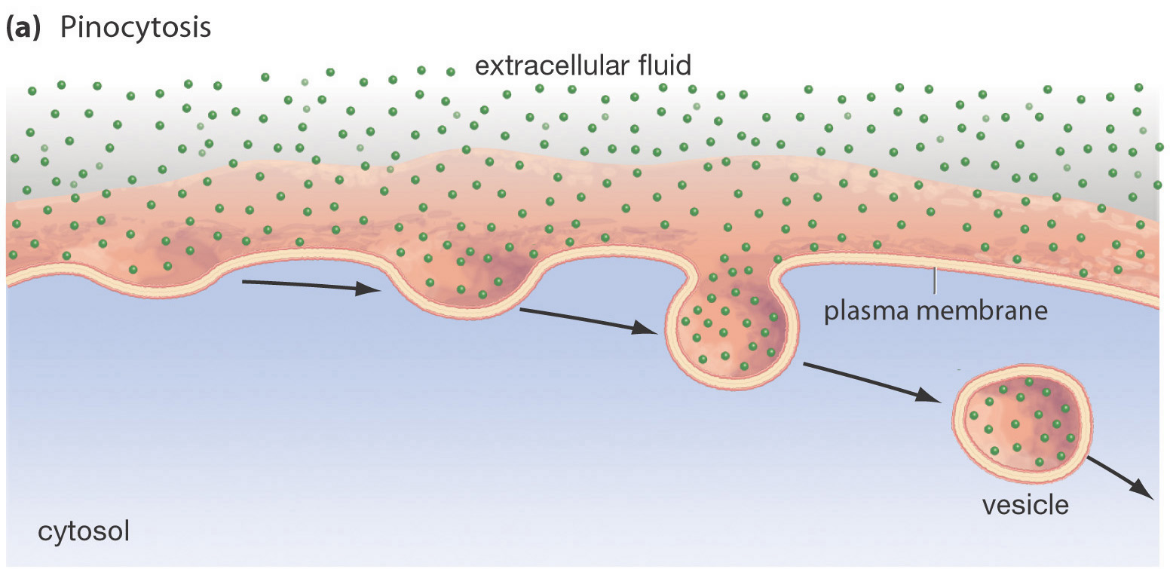
Pinocytosis
Most common form of endocytosis.
Takes in dissolved molecules as a vesicle.

Slide 38
Pinocytosis
Cell forms an invagination
Materials dissolve in water to be brought into cell
Called “Cell Drinking”

Slide 39
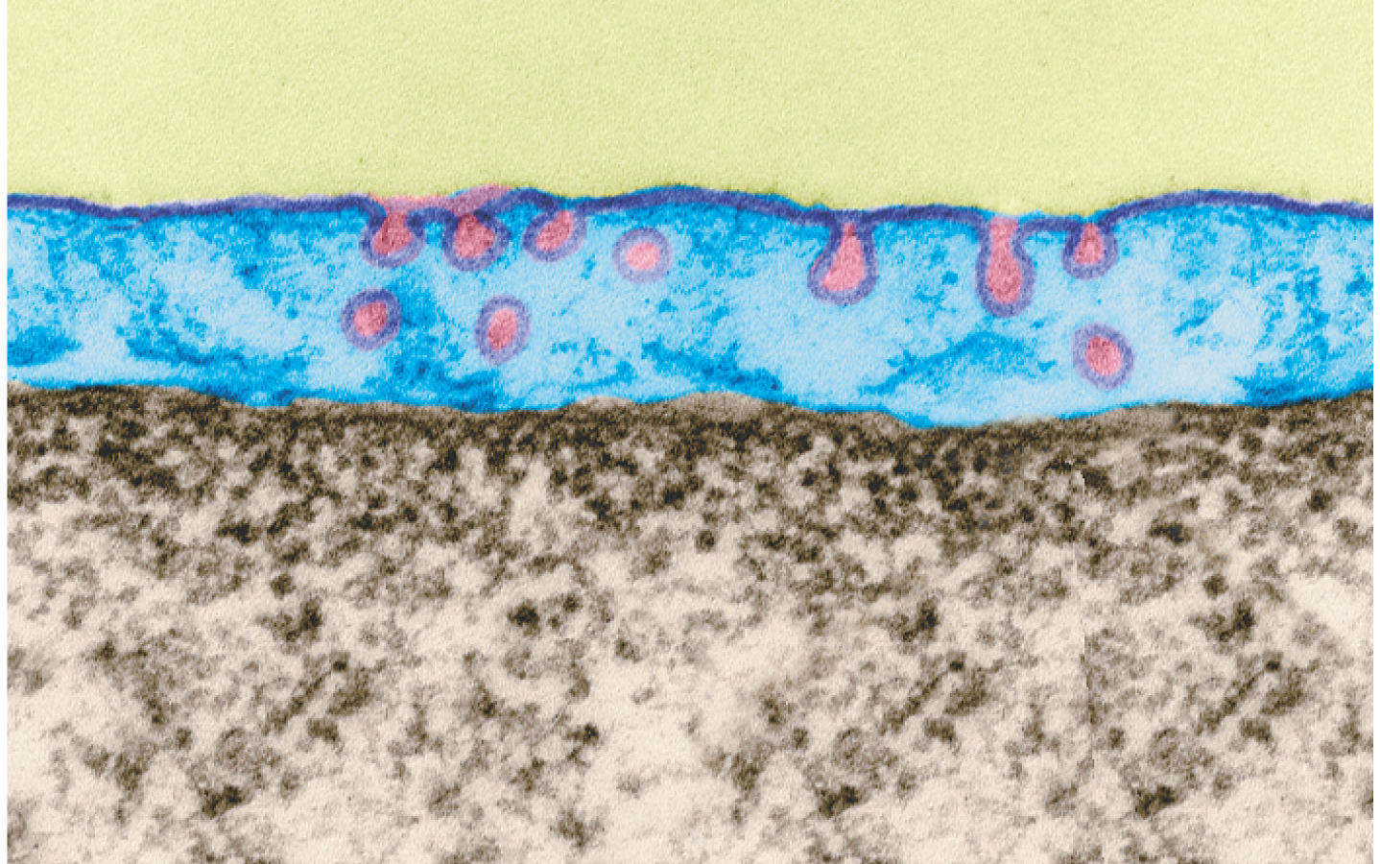
Example of Pinocytosis
pinocytic vesicles forming
mature transport vesicle
Transport across a capillary cell (blue).

Slide 40
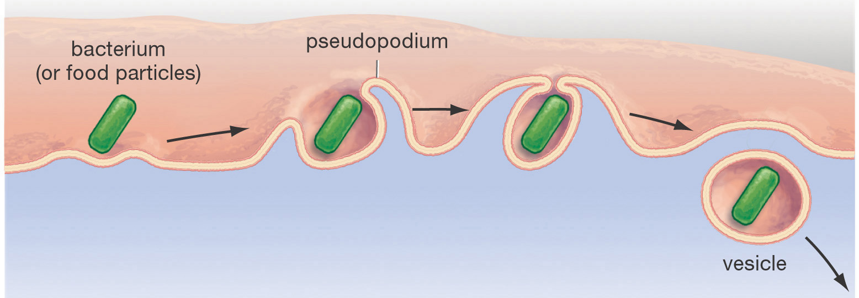
Endocytosis – Phagocytosis
Used to engulf large particles such as food, bacteria, etc. into vesicles
Called “Cell Eating”

Slide 41
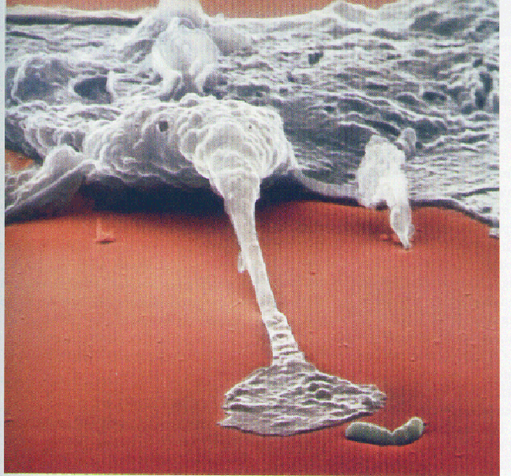
Phagocytosis About to Occur

Slide 42
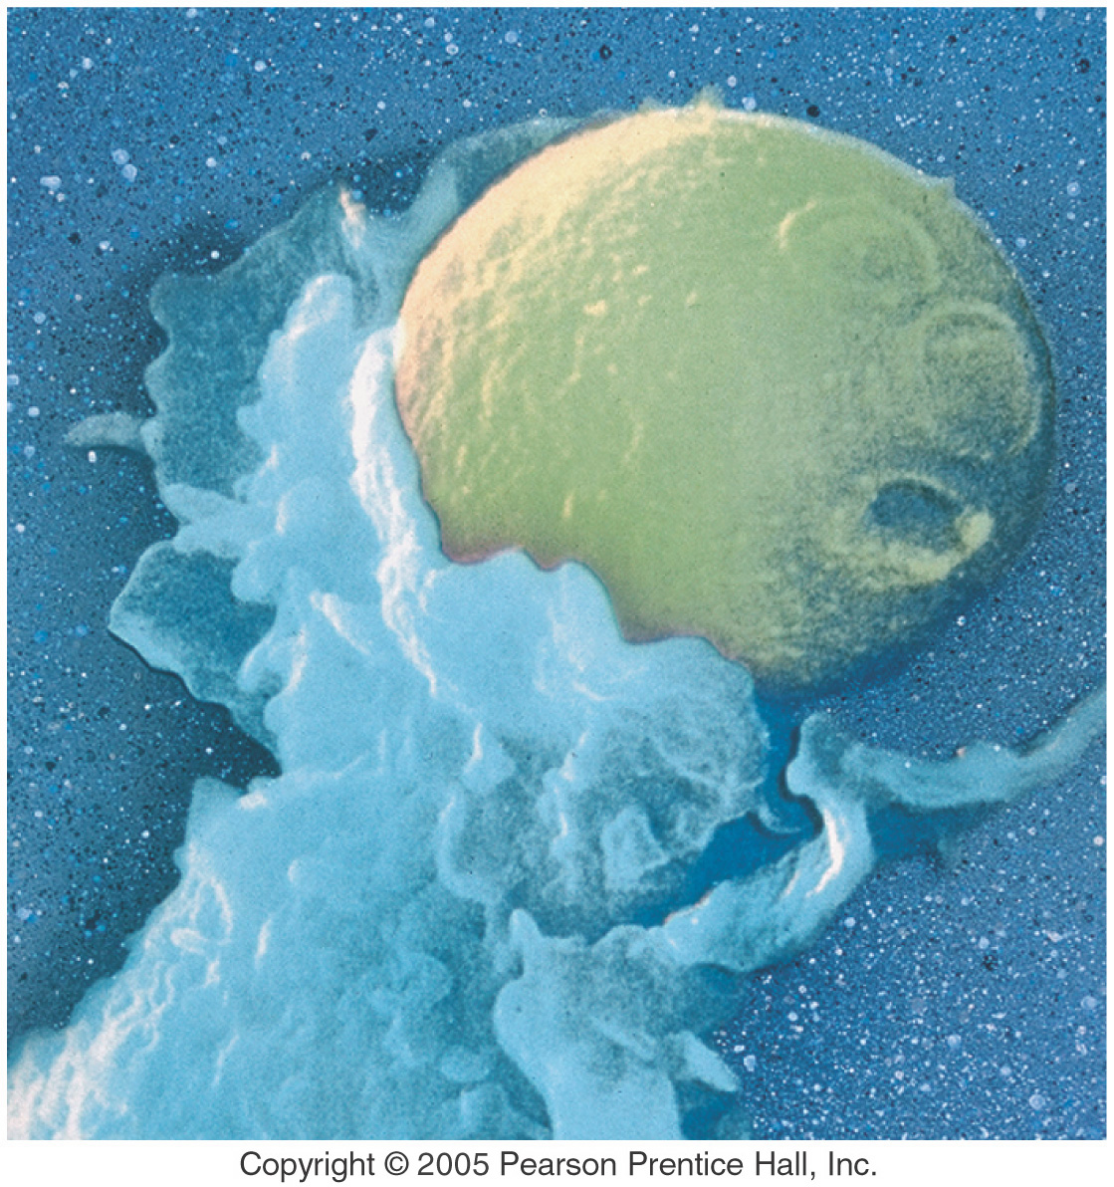
Phagocytosis - Capture of a Yeast Cell (yellow) by Membrane Extensions of an Immune System Cell (blue)

Slide 43
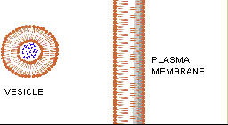
Exocytosis The opposite of endocytosis is exocytosis. Large molecules that are manufactured in the cell are released through the cell membrane.
Inside Cell
Cell environment

Slide 44
The End

